Slide 1



CELTIC-NEXT
Proposers Brokerage Day
24th February 2025, Barcelona
Pitch of the Project Proposal
Wi-Excellence
Mehmet Şükrü Kuran, Airties
sukru.kuran@airties.com

Slide 2

Teaser
What do I gain from this?
Quantitatively evaluating QoS-sensitive-application-experience of end-users, finding root cause of bad experience in the networking pipeline (i.e., Wi-Fi & FWA), and proposing cures to alleviate these problems.
What is your value proposition?
Measuring end-user experience, pinponting the problem, and proposing solutions
Why should I care?
As an ISP or application vendor, if you want to increase end-user experience and reduce churn of customers
www.celticnext.eu Wi-Excellence, Mehmet Şükrü Kuran, Airties, sukru.kuran@airties.com

Slide 3
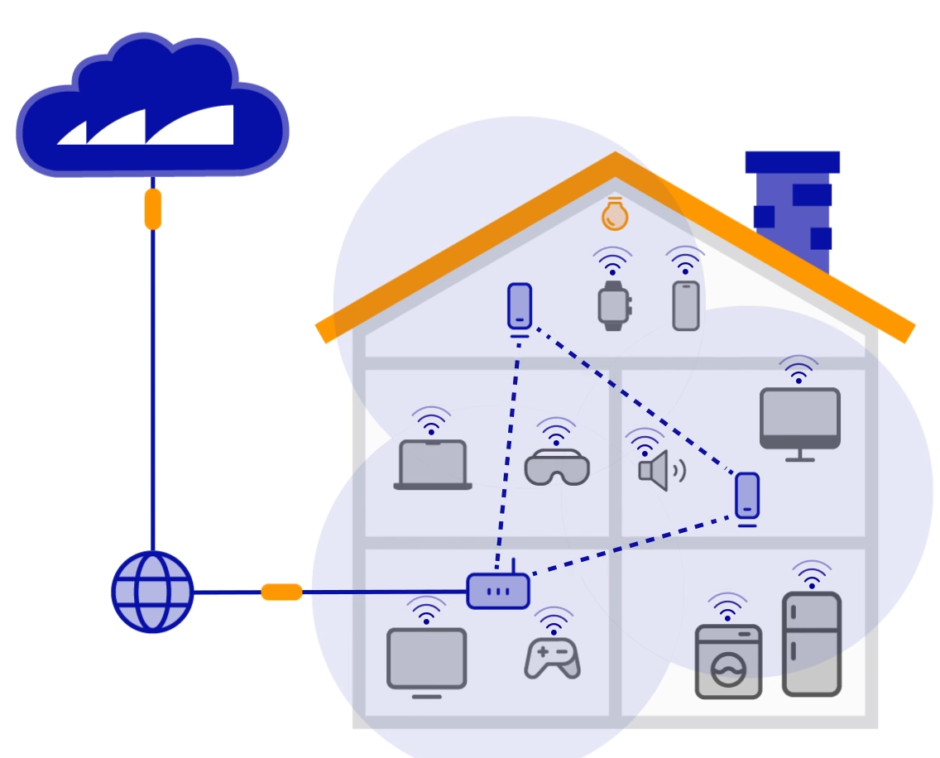
Organisation Profile
Airties provides managed Wi-Fi solutions for the Tier 1 Internet Service Providers (ISPs) across the globe.
Currently, Airties integrates into and remotely manages more than 35 million home Gateways mostly in USA and Europe.
Airties’ SW solutions optimize Wi-Fi connections and home networks, leading optimized user experience.
Airties utilizes AI-powered methods for optimization of home networks.
www.celticnext.eu Wi-Excellence, Mehmet Şükrü Kuran, Airties, sukru.kuran@airties.com

Slide 4








Proposal Introduction (1)
Session quality is 65/100
Wi-Fi has
some problems
Terrible experience ☹
<App quality>
Application
Server
No idea about wireless edge
Wi-Fi RG
User running application
ISP Core network
<Quality, network state, cure>
No idea about app. experience
www.celticnext.eu Wi-Excellence, Mehmet Şükrü Kuran, Airties, sukru.kuran@airties.com

Slide 5
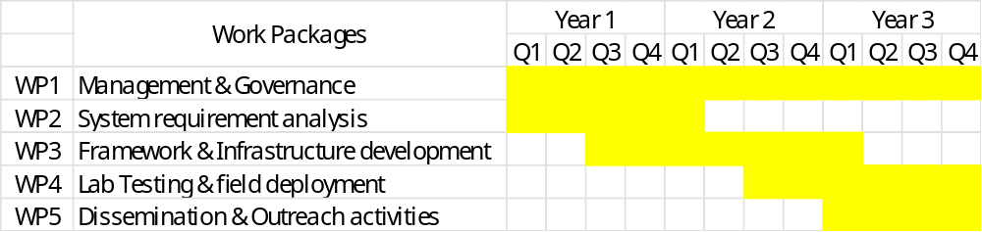
Proposal Introduction (2)
A framework for quantitively measuring application QoE using application vendor information, crisscrossing them with wireless edge issues, and proposing cures.
Improved end-user Internet experience, improved end-user QoE on QoS-sensitive applications
Self-healing wireless edge and fixed wireless access that works on quantitative quality data
www.celticnext.eu Wi-Excellence, Mehmet Şükrü Kuran, Airties, sukru.kuran@airties.com

Slide 6

Partners
Managed Wi-Fi Solutions
Looking for partners (Türkiye consortium is already full)
Application vendors of QoS-sensitive applications
STA vendors for which QoS-sensitive applications are critical
ISPs, Cellular and Broadband operators focusing on QoS/QoE of their customers
Research bodies for evaluating QoS/QoE
www.celticnext.eu Wi-Excellence, Mehmet Şükrü Kuran, Airties, sukru.kuran@airties.com

Slide 7
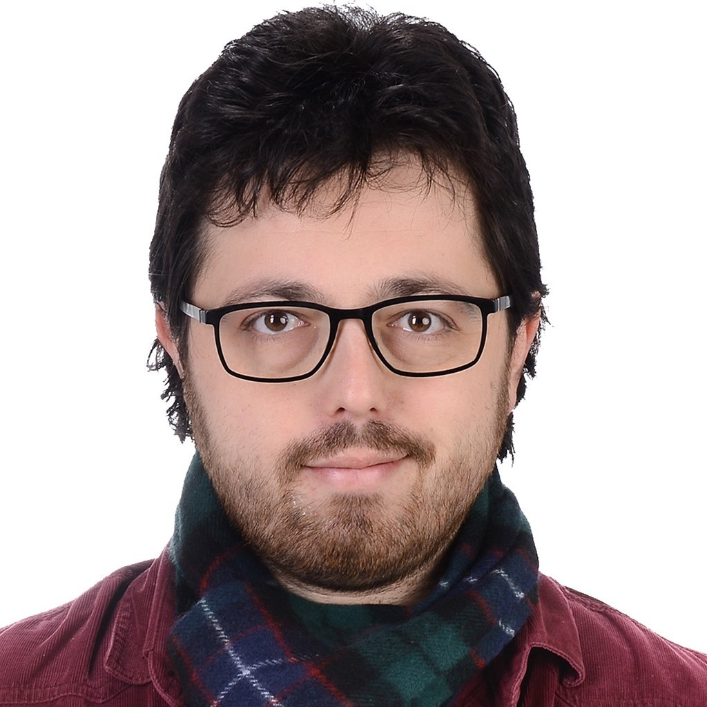

Contact Info
For more information and for interest to participate please contact:
Mehmet Şükrü Kuran
sukru.kuran@airties.com
                Presentation is available via:

