Slide 1




CELTIC-NEXT
Pitch of
the Project Proposal
24th of February 2025, Barcelona
Next Generation AI-native Mobile Network Architecture for Emerging AI Agents
Your Logo
Your Logo
Dr. Andrey Krendzel, Dr. Pouria Khodashenas, Dr. Ali Hamidian (Huawei Technologies Sweden AB)
andrey.krendzel@huawei.com
pouria.khodashenas@huawei.com
ali.Hamidian@huawei.com

Slide 2


Teaser
What is the main benefit of the idea/proposal?
Native AI-based - next-generation architecture for advanced intelligent communication with humans or machines (robots) with emerging AI agents.
What makes the added value?
Building blocks and features of future native AI-based system architecture:
the value proposition, key features, value scenarios, and requirements of the AI-native architecture;
the target architecture, network agent functions, capabilities, and interfaces driven by AI agents;
the logical architecture, network functions, interface protocols;
6G AI telecom governance
Why should I participate in the project?
It is an opportunity to influence the future system architecture of mobile networks.
Next Generation AI-native Mobile Network Architecture for Emerging AI Agents
Andrey Krendzel, Pouria Khodashenas, Ali Hamidian, Huawei Sweden andrey.krendzel@huawei.com; pouria.khodashenas@huawei.com; ali.hamidian@huawei.com

Slide 3
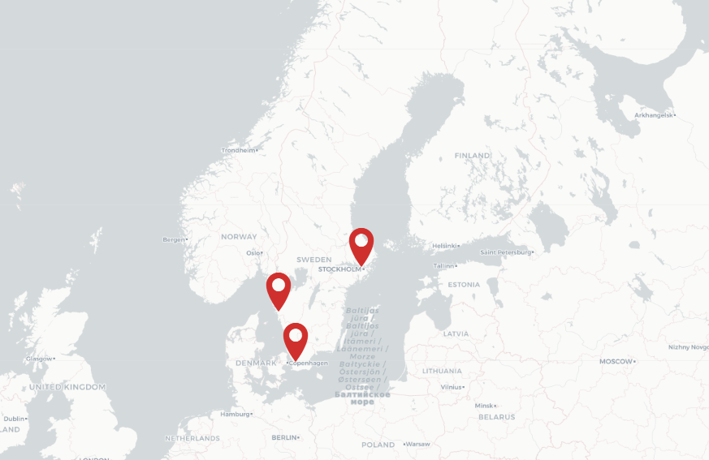
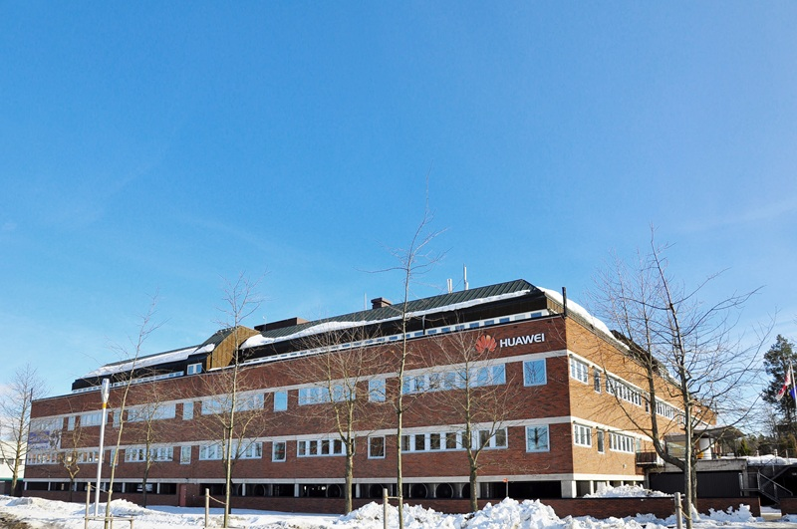
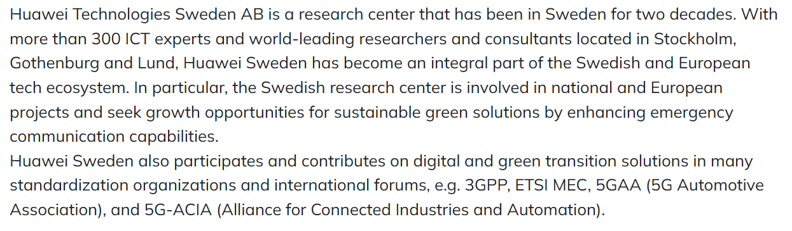
Organisation Profile
Huawei Sweden –Stockholm Research Center (SRC)
Stockholm
Gothenburg
Lund
In 2000, Huawei established its first overseas R&D office in Stockholm, Sweden. Since then, Huawei has established several research centers across Europe.
Next Generation AI-native Mobile Network Architecture for Emerging AI Agents
Andrey Krendzel, Pouria Khodashenas, Ali Hamidian, Huawei Sweden andrey.krendzel@huawei.com; pouria.khodashenas@huawei.com; ali.hamidian@huawei.com

Slide 4
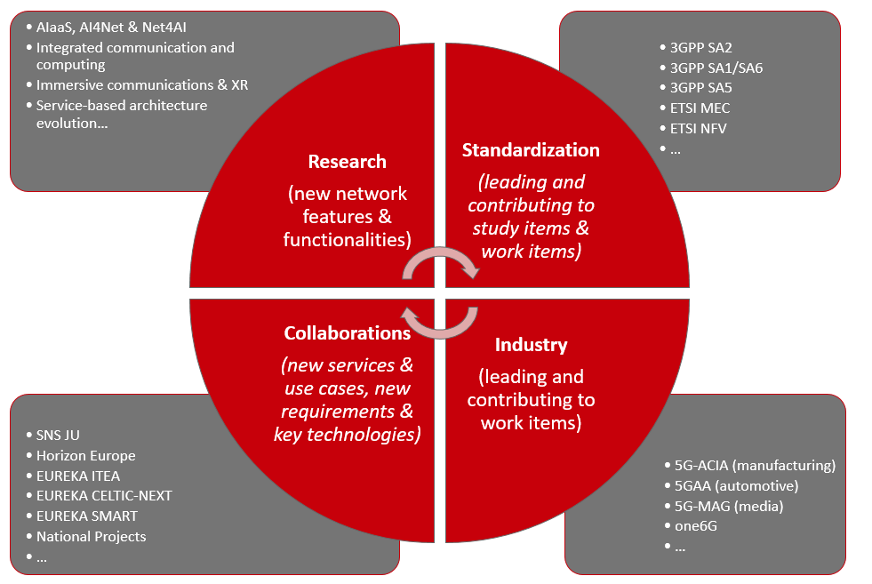
Team Profile
Stockholm Research Center (SRC) - Cloud Core Network Group
Next Generation AI-native Mobile Network Architecture for Emerging AI Agents
Andrey Krendzel, Pouria Khodashenas, Ali Hamidian, Huawei Sweden andrey.krendzel@huawei.com; pouria.khodashenas@huawei.com; ali.hamidian@huawei.com

Slide 5
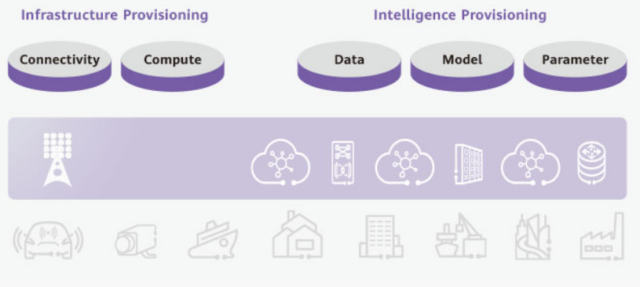
Proposal Introduction
The rapid development of AI, including emerging AI devices, AI applications and services, is driving the need for an AI-native architecture that integrates intelligence into network functions, procedures and operations. This proposal explores next-generation system architecture to support the needs emerging AI agents - intelligent systems capable of real-time decision-making, adaptive learning, and human-like interaction.
Source: AI: The bridge to 6G, Huawei WP, 2024. https://www.huawei.com/en/huaweitech/publication/202401/ai-bridge-to-6g
By embedding AI agents directly into the communication infrastructure, this approach enhances efficiency, autonomy, and user experience across various domains, from human-machine collaboration to autonomous network planning and design. Unlike conventional AI-driven optimizations, a native AI-based network architecture treats AI as an intrinsic component rather than an add-on, enabling more dynamic, flexible and scalable interactions. This research aims to define the basic principles of such architecture, investigate the impact of AI agents on mobile network architecture, and propose a framework for their implementation, positioning emerging AI agents as key enablers of next-generation communication systems.
Next Generation AI-native Mobile Network Architecture for Emerging AI Agents
Andrey Krendzel, Pouria Khodashenas, Ali Hamidian, Huawei Sweden andrey.krendzel@huawei.com; pouria.khodashenas@huawei.com; ali.hamidian@huawei.com

Slide 6
Proposal Introduction
The project length: 36 months, starting from Q4 2025 or Q1 2026
Key words: AI-native mobile network architecture, AI agents, 3GPP system architecture, Network for AI, AI for Network
Expected outcome: This project will deliver a novel AI-native communication architecture that integrates emerging AI agents for enhanced real-time adaptability, automation, and intelligent interaction towards next-generation networks.
Potential impacts: The proposed native AI-based network architecture with emerging AI agents will improve human-machine and machine-to-machine communication by enabling more autonomous, context-aware, and efficient interactions. This could drive advancements in 6G networks, IoT ecosystems, and AI-driven digital assistants, paving the way for more intelligent and seamless communication infrastructure.
Next Generation AI-native Mobile Network Architecture for Emerging AI Agents
Andrey Krendzel, Pouria Khodashenas, Ali Hamidian, Huawei Sweden andrey.krendzel@huawei.com; pouria.khodashenas@huawei.com; ali.hamidian@huawei.com

Slide 7
Partners
We are looking for
a partner who can lead the proposal
Partners that have “Network for AI” and/or “AI for Network” background to form international consortium from representatives of different countries.
Next Generation AI-native Mobile Network Architecture for Emerging AI Agents
Andrey Krendzel, Pouria Khodashenas, Ali Hamidian, Huawei Sweden andrey.krendzel@huawei.com; pouria.khodashenas@huawei.com; ali.hamidian@huawei.com

Slide 8
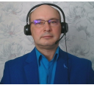

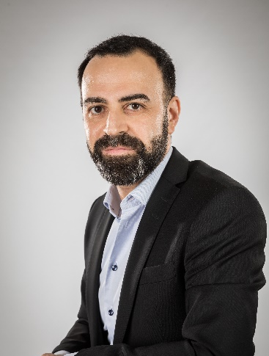
Contact Info
For more information and for interest to participate please contact:
Dr. Andrey Krendzel, Huawei Technologies Sweden AB
andrey.krendzel@huawei.com
Dr. Pouria Khodashenas, Huawei Technologies Sweden AB
pouria.khodashenas@huawei.com
Dr. Ali Hamidian, Huawei Technologies Sweden AB
ali.hamidian@huawei.com

