Slide 1



Socio SkillsUp
Empower. Engage. Employ
INCLUSIVE SMART FACTORY
PRESENTATION
www.socioskillsup.co.za

Slide 2
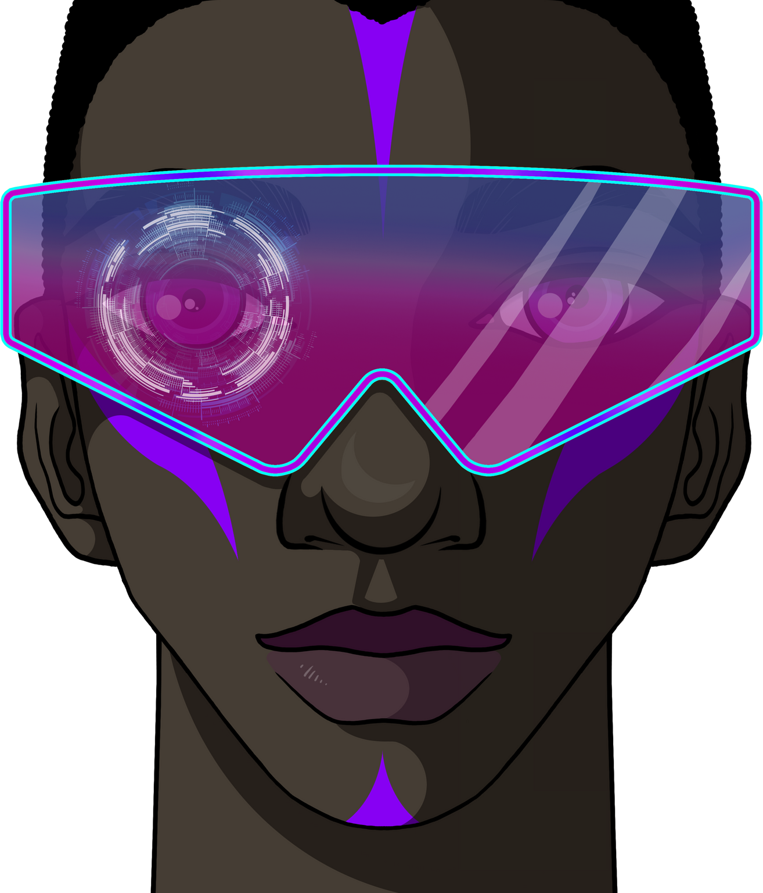

02
Socio SkillsUp
INTRODUCTION
As a disability technology consulting company, Socio SkillsUp is committed to empowering persons with disabilities by facilitating their transition into the open labor market. This proposal outlines our vision for establishing a Smart Factory designed to transform the employment landscape for individuals with disabilities, harnessing smart technology to create a more inclusive workforce.
www.socioskillsup.co.za

Slide 3

Socio SkillsUp
PROBLEM STATEMENT
The umeployment rate for persons with disabilities in South Africa is estimated to be over 60% higher the nationsal average. Many Persons with disabilities possesess valuable skills and talents but face significant barriers to employment due to lack of accessible work enviroments and specialised training opportunties. Many workplaces lack the necessary accommodations, which restricts access to meaningful job opportunities.
03
www.socioskillsup.co.za

Slide 4


Our Solution
Smart Factory for Persons with Disabilities
The Smart Factory for persons with disabilities offers a comprehensive solution to the employment barriers faced by this demographic by leveraging advanced technologies
04
www.socioskillsup.co.za

Slide 5

Socio SkillsUp
Innovative Production
Our Smart Factory will utilize cutting-edge Assertive technology, including IoT, AI, Automation, Automated Guided Vehicles, Augmented Reality and Assertive Technolgies to streamline production processes. This will lead to reduced operational costs and increased output.
05
UNIQUE VALUE
www.socioskillsup.co.za

Slide 6


MARKET OPPORTUNITY
Growing Demand for Inclusivity: Companies are increasingly recognizing the importance of diversity and inclusion in the workplace. The global market for disability-inclusive products and services is expanding rapidly, presenting a lucrative opportunity.
Technological Advancement: The integration of smart technologies is reshaping industries. By capitalizing on this trend, our Smart Factory will meet the demands of a modern workforce while ensuring accessibility.
Untapped Talent Pool: Persons with disabilities represent a significant yet often overlooked segment of the workforce. By tapping into this talent pool, we can enhance productivity and innovation.
06
www.socioskillsup.co.za

Slide 7

07
Socio
SkillsUp
SERVICE OFFERINGS
Socio SkillsUp provides a range of products including:
CUSTOM SOFTWARE DEVELOPMENT
TRAINING PROGRAMS TAILORED FOR PERSONS WITH DISABILITIES
SMART MAUNFACTURING SOLUTIONS
ASSERTIVE TECHNOLOGY SOLUTIONS
WORKPLACE ACCESSIBILITY CONSULTING
Building an Inclusive Future Together
www.socioskillsup.co.za

Slide 8

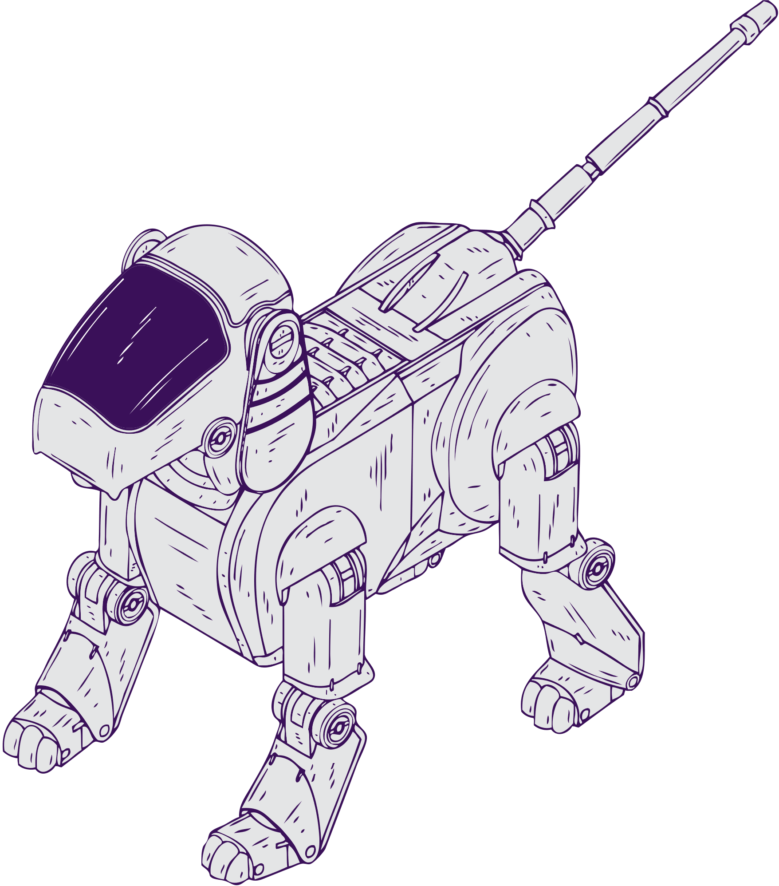

08
Socio
SkillsUp
BUSINESS MODEL
Our business model is based on a combination of project-based contracts, subscription services, and long-term partnerships. We offer flexible pricing plans tailored to the size and needs of each client, ensuring affordability and value. Our focus on building strong client relationships ensures repeat business and sustained growth.
www.socioskillsup.co.za

Slide 9



CASE STUDIES
09
Transition into Employment
The lack of tran sition pathways for persons with disabilities to access employment opportunities is a pressing issue that needs to be addressed. Establishing an inclusive smart factory presents a unique opportunity to create structured pathways that empower individuals with disabilities and enhance their employability. By investing in skills development, practical experience, and employer engagement. The smart factory can become a transformative model for inclusive employment in South Africa for persons with disabilities.
www.socioskillsup.co.za

Slide 10





Socio
SkillsUp
THANK YOU!
info@socioskillsup.co.za
081 779 4843
www.socioskillsup.co.za
10

