Slide 1
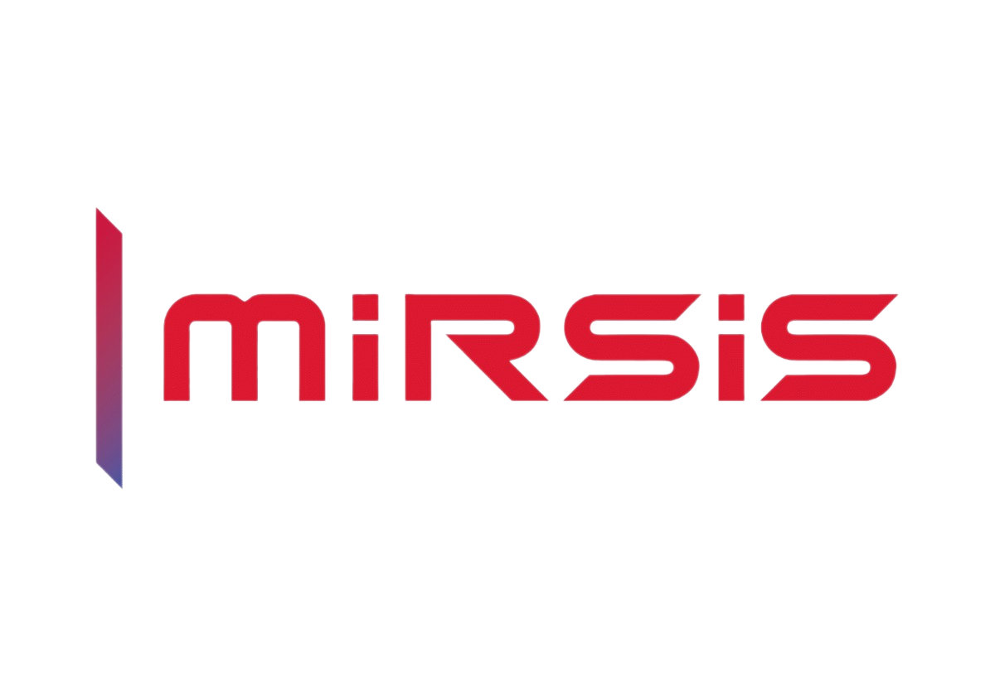
FINANCIAL RISK MANAGEMENT
& PLANNING

Slide 2
Contents
Mirsis – Company Information
References
Problem
Solution
Market Opportunity
Looking for Partners
Contact

Slide 3
Mirsis – Company Information
Turkey's 25 Fastest Growing
Company”, we ranked 10th in the survey (TEPAV)
Ranked 12th in its category in the Informatics 500 Ranking by i-Research Research Center
2 TUBITAK 1501 Application was made
3 Eureka Project Applications were made
Commencement of Operations
First in Türkiye
CMMI SVC/3
Miera & Odak Career Group Companies
1 TUBITAK 1501 Support Received
Quality Certificate (ISO 9001)
ISO 27001
R&D Center
2008
2011
2013
2014
2016
2019
2020
2022
2023
Started Operating as Software House
Started to provide services in software development, testing, system continuity and management
Our first project, MF2010, was realized for Yapı Kredi in 2010.
Economic Policy Research Foundation of Turkey (TEPAV) 10/25
Mirsis was the first IT company in Türkiye to receive CMMI-SVC+SSD.
A patent application was realized (Multifactor Passenger Congestion Estimation System with Recurrent Neural Networks).
Participation was provided with an academic publication titled “Location Prediction with Machine Learning on Location based Social Networks (International Conference on Computational Methods in Applied Sciences” for the ICCMAS 2019 Conference, an international event.
3200612 - Development of a Large-Scale Ready-to-Use Financial Planning and Analytical Platform Supported by Multi-Criteria Forecasting and Risk Analysis Simulation

Slide 4
Mirsis – Company Information
Mirsis Information Technologies continues to develop new products and carry out R&D activities on higher performance and more effective products that can replace existing products with its R&D team, which can analyze the needs on a sectoral basis in the fields of software development, testing services, system continuity and management with the know-how gained since 2008, collaborations developed and experiences gained in different sectors, and aims to meet the changing market conditions, consumer demand, maintain the competitive position of the product or brand and contribute to operational efficiency by increasing market share.

Slide 5

























References

Slide 6

Problem
The main problem of the project is that SME’s face difficulties in accessing sophisticated financial modeling and risk management solutions due to the lack of open standardization in digital financial data exchange. Existing static models are unable to adapt to the rapidly changing risk environment, which negatively impacts SMEs' financial performance.

Slide 7

Problem
Lack of Standardization: The lack of open standardization in digital financial data exchange limits access to unregulated financial system and risk management solutions, especially for SMEs.
The Need for Dynamic Risk Management: Existing financial risk models are static and unable to adapt to fast-moving business conditions. This prevents SMEs from operating effectively in a dynamic risk environment and increases the risk of bankruptcy.
SMEs' Access Problem: Major IT upgrades and financial financial shortfalls make it difficult for SMEs to take advantage of such platforms, but they can suffer serious damage from high-impact scenarios.

Slide 8
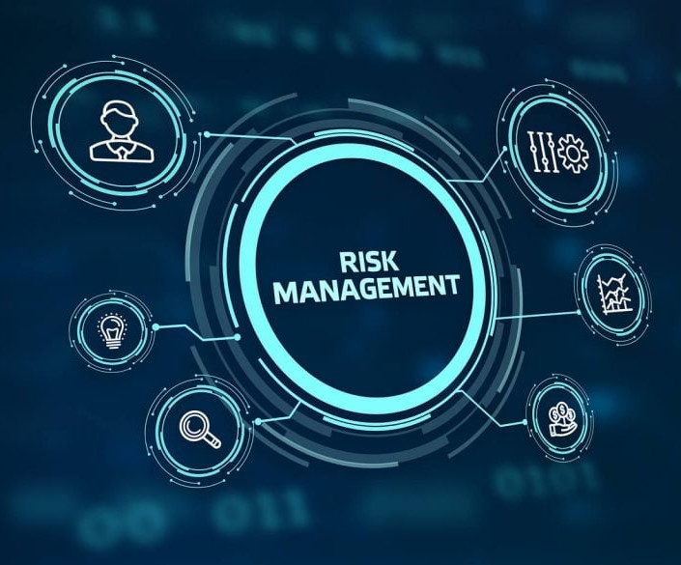
Solution
Our project aims to use international data exchange standards such as XBRL Global Ledger (GL) to deepen the financial data analysis of SMEs and develop dynamic risk management models. This will provide a solution that will allow businesses to manage their risks more effectively and quickly adapt to changing business conditions.

Slide 9
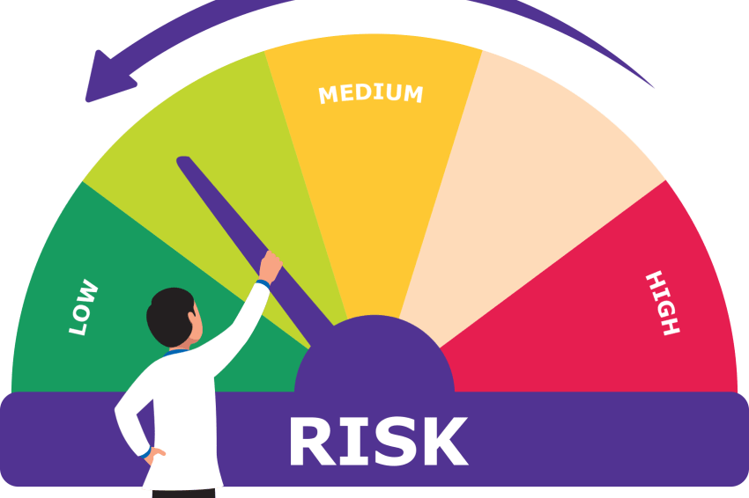
Solution
Use of International Standards: By using international financial data exchange standards such as XBRL Global Ledger (GL), SMEs' financial data can be further analyzed and dynamic risk information can be learned.
Dynamic and Learning Models: The project aims to develop continuously learnable risk models that can adapt to business conditions. By capturing early warning, these models enable risks to enable more effective programs.
Suitable Solutions for SMEs: The five prototypes developed under the project will meet the financial risk management and planning needs of SMEs, enabling them to create a more proactive and effective risk management strategy.

Slide 10
Market Opportunity
In banking, the project aims to enhance due diligence and credit risk assessment processes for loan customers, while in investment, the new platform is designed to strengthen the due diligence processes of investee companies.
By reducing the bankruptcy rate in the EU, which saw a significant increase post-Covid, the project seeks to make a substantial economic impact, contributing to revenue growth and preserving a large number of jobs. This approach will help sustain employment opportunities over time, as SMEs will be better equipped to navigate low-probability, high-impact risks through the use of early warning signals.

Slide 11

Looking for Partners
Mirsis Information Technologies within the scope of this project, will perform its duties as a use case provider for the financial sector, project coordination and execution, ML research, financial modeling expertise.
Risk modelling architecture expertise
Computational Finance, financial modelling research, dynamic machine learning modelling
Cloud supported big data management, data modelling and ML implementation, scalable systems
Risk framework (enterprise, operational, financial compliance) expertise and non-financial risk research and use cases provider
Custom data modelling and machine learning modelling expertise
Machine learning assembly line and MLOps automation expertiseAI embedded credit risk modelling for Micro and Small segment expertise

Slide 12
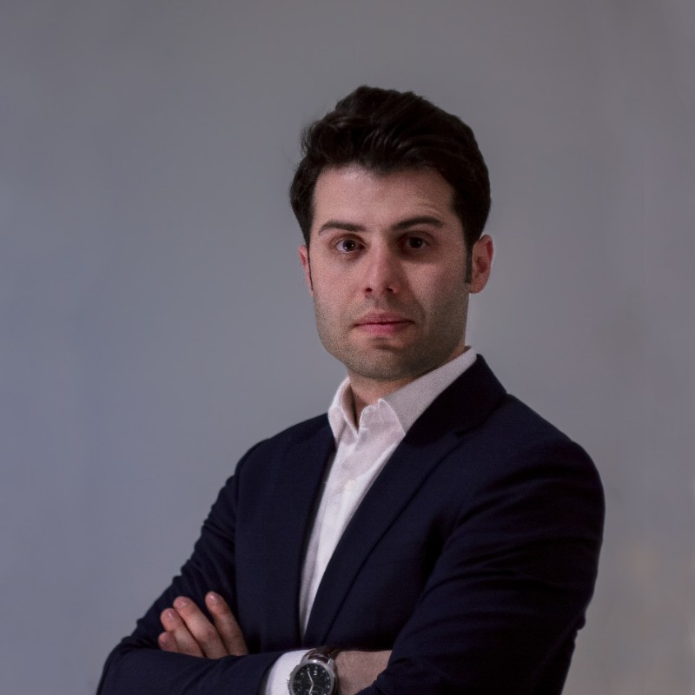
Contact
For more information and for interest to participate please contact:
Nima Najaflou
R&D Manager, Mirsis Information Technologies
Nima.Najaflou@mirsis.com.tr
+90 (544) 316 72 44
Neighborhood of Atatürk, Girne Street
No:1/A, 34758
Ataşehir/İstanbul - Türkiye
https://www.mirsis.com.tr/

